Slide 1
Loading

Slide 2



아로마인드 로그인

Slide 3
Login

Slide 4

Email
Password
Login
Don't have account?
Create an account.

Slide 5
Email
Password
Login
Don't have account?
Create an account.

Slide 6
Remote Controll

Slide 7







Slide 9


Slide 13
Sentiment Setting

Slide 14
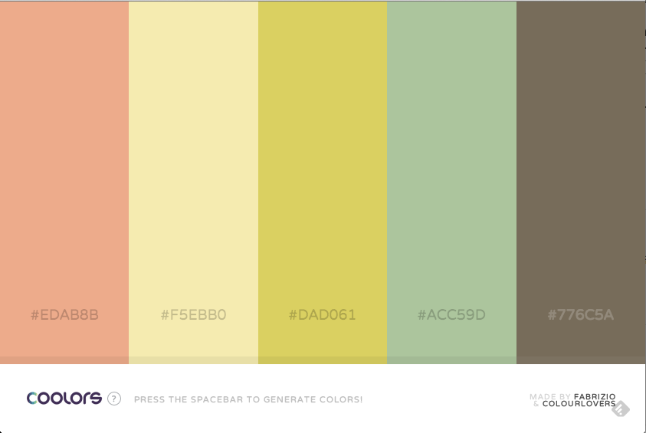
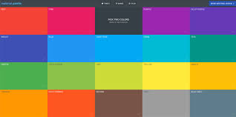
positive
neutral
negative
+

Slide 15
positive
neutral
negative
+

Slide 16
positive
neutral
negative
+

Slide 17
Sentiment Setting(2)

Slide 18
positive
neutral
negative
+

Slide 19
positive
neutral
negative
+

